Slide 1
S3 Course Choice
January 2024

Slide 2
Aims:
To share the process with you
To share the key dates for your child
To give you the opportunity to ask questions
To help us to work together to get the best possible course portfolios for all students

Slide 3
Personalisation and Choice
S1
S2
S3
S6
S5
S4
Progression from primary - all curriculum areas
Developing learning from S1, specialising within Curriculum Areas
Personalisation and choice
Qualifications and Wider Achievement
Senior Phase
Learning Review
Learning Review
Broad, General Education

Slide 4
The Process
Research your options
Everyone will study:
English
Maths
French
Social Education
Physical Education
Notes:
Aim: to help parents understand the system and processes in place now – first big decision in their education – important to get it right if possible but to remember the beauty of the system is that there are flexible pathways over the next four years.
Process: In S2 we begin personalisation and choice.

Slide 5
The Process
Your child will then also select 6 additional subjects
Personalisation and choice
Allows depth of study
Ensures solid basis for learning in S4
Details of what subjects are available in each category are in the Learning Review booklet and summarised in the leaflets sent to you.

Slide 6
Reserves
Your child will also select TWO reserves:
Cannot guarantee all pupils will receive all 5 choices
Prioritise 1 – 5 plus 2 reserves
Must be prepared to take any five of the seven selected.
Please note, your child will be asked to select three electives but will only study one of these subjects.

Slide 7
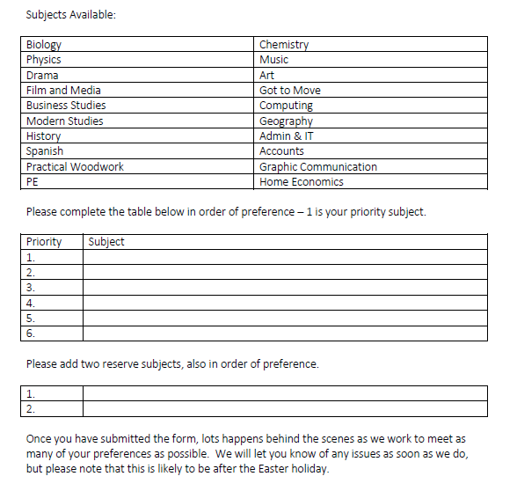
The Paperwork

Slide 8
Points to Consider
Future course/career priorities – S4 and beyond
Interests and aptitude
Most likely areas of success
Encourage your child not to be swayed by:
Friendships
Teachers
Stereotypes

Slide 9
The Support
How can we work together to get this right?
SE lessons considering options
1:1 meetings with Pupil Support to discuss choices
Discussions with teachers for advice
Careers adviser appointments
S2 Careers Event today
Research careers/courses/apprenticeships online
Access myworldofwork website for a range of resources
Plan ahead – what will you take in S4?
Notes:
Use the advice of teachers, use MyWow, no career plan can be an advantage as pupils can focus on the subjects they enjoy and experience most success in.
Discourage from making decisions based on friends, teachers they like etc.
Recommend thinking ahead to S4 too – it is harder to go back into a course in S4 if you have come out of it for S3, missed work etc.

Slide 10
Key Dates:
Week Beginning 22nd January:
Course Choice Sheet issued in SE – also available on the school website
SE lesson to support choices
S2 Careers Event
S2 Briefing and Parent Information session
Week Beginning 29th January:
Submit completed form to DMT Tutor
1:1 meetings with Pupil Support Leaders
Early February– Process completed

Slide 11
Behind the Scenes!
Whole school course choice
Analysis of numbers and classes for each subject
Analysis of staffing
Meeting the needs of as many pupils as possible
Checks and balances
Creation of timetable
Communication with pupils re problems/challenges
Individual timetables issued
New timetable starts
Notes:
Meeting the needs of all – system does this for us but then checks to ensure that no one person is disproportionately affected and ‘human’ checks made to support system checks.
Individual timetables issued as early as possible but note that timing is tight to allow choice as late as possible
ESB/SfL/other supports reviewed

Slide 12
Questions?

